Slide 1

Critical Chain Project Management
CCPM
Revolutionary Concept in Projet Management based on Eli Goldratt’s TOC

Slide 2
Presentation Flow
The Conflict
Critical Chain Approach
Critical Chain Steps
The CCPM Difference
Updating Task
Executive Decision Support
Single Project Solution
Multi-Project Scheduling
What do we need to do
The results

Slide 3
The Conflict
We must..
Avoid the impact of Parkinson’s law
Parkinson Says…...
Schedule tasks without “safety”
Work expands to fill (and often exceed) the time allowed.
Minimize Project Lead Time
In order to….
Manage Projects Successfully
Conflict
Murphy Says…...
Assure Project Promise
Schedule tasks to include “safety”
Whatever can go wrong, will.
Allow for the inevitability of Murphy’s law.

Slide 4
The Solution for the Conflict
is
Critical Chain
Project Management

Slide 5
The Critical Chain Approach
Takes Critical Path concepts further
Pull protection from tasks & aggregate for project
Resolve resource contention
Set clear priorities
Focus measures to support decision making
Pace the start of new projects

Slide 6
Step 1: Create the Network
A.) Use average task times
B.) Place tasks at late start
10:Design
4:Dev
4:Design
6:Proto
8:Dev
4:Tst
5:Design
5:Design
2:Dev
2:Dev
2:Dsn
3:Proto
4:Dev
2:Tst

Slide 7
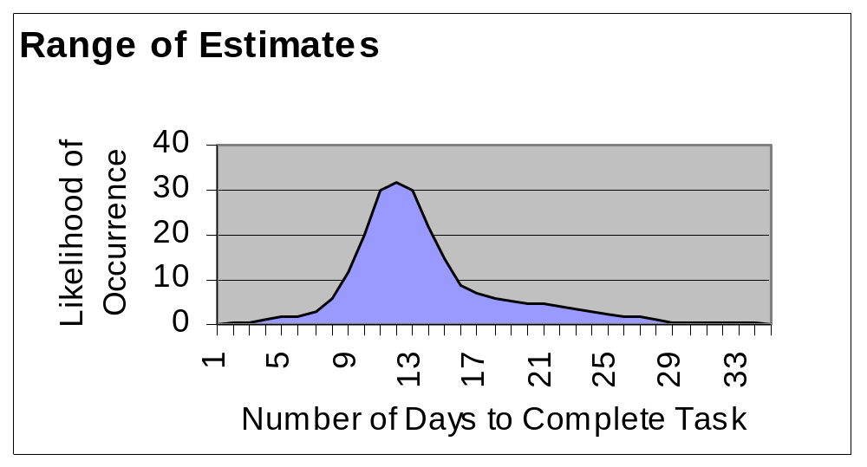
Tasks Estimates are Inflated
50% probability
estimate
95% probability
estimate
90% probability
estimate

Slide 8
Step 2: Identify the Critical Chain
A.) Eliminate resource contention
2:Dev
5:Design
2:Dev
4:Dev
4:Dev
2:Dsn
3:Proto
4:Dev
2:Dsn
2:Dsn
3:Proto
3:Proto
2:Tst
2:Tst
B.) Identify the Critical Chain
The Critical Chain
The longest path through the network considering
both task and resource dependencies

Slide 9
Step 3: Deal with Uncertainty
What is the chance of completing when “planned”?
The Project Buffer protects the project due date
?
5:Design
2 Dev
2:Dsn
3:Proto
4: Dev
2:Tst
6.5: Project Buffer
Where else is the project vulnerable to disruptions?
Feeding buffers protect the Critical Chain
Feeding Buffer
5:Design
5:Design
2: FB
2 Dev
2:Dsn
3:Proto
4: Dev
2:Tst
6.5: Project Buffer

Slide 10
The CCPM Difference
10:Design
4:Develop
4:Design
6:Prototype
8:Develop
4:Test
No Resource
Contention
5:Design
Feeding Buffer
2:Dev
2:Dsn
3:Proto
4:Dev
2:Tst
Project Buffer
Shorter Project
Better Protected

Slide 11
Step 4: Finalize the Plan & Begin
Operating Rules
  Set clear and stable priorities
    CC first
    Others FCFS unless changed by management
  Reduce multitasking
Update task status regularly
  Days of work remaining
Use buffer status to focus attention and energies

Slide 12
Executive Decision Support
CCPM provides leaders real-time information on project status allowing them to focus their attention and resources
Action
Threshold
Project Due Date
↑
Project Buffer Used
Planning
Threshold
Project Early Finish
Complete
Critical Chain percent complete →

Slide 13
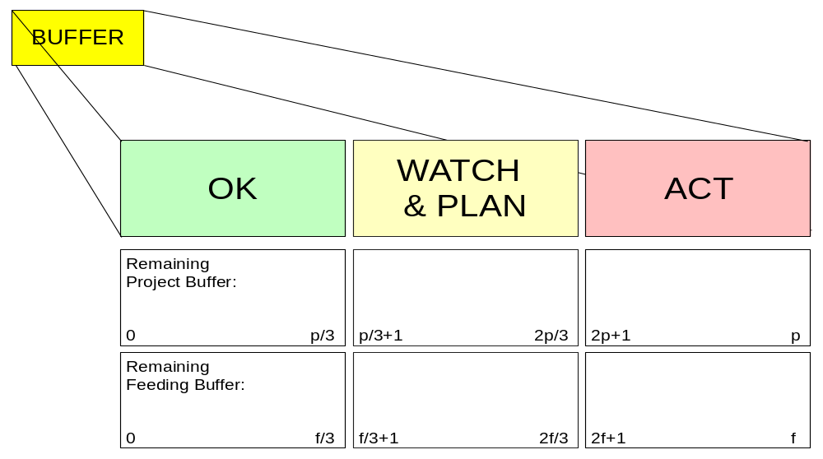
Buffers are used to provide focus and early warning to protect the critical chain and due date
Executive Decision Support

Slide 14
The Single Project Solution
Within a project
  Resolves resource contention
  Starts tasks when they need to be started
  Provides clear priorities
    CC first
    Others FCFS unless changed by management
  Shifts focus from tasks to project
What about multi-project organizations?

Slide 15

Starting New Projects
Which one should I start first?
1
2
3
4
5:Design
2: FB
2 Dev
2:Dsn
3:Proto
4: Dev
2:Tst
6.5: Project Buffer
5:Design
2: FB
2 Dev
2:Dsn
3:Proto
4: Dev
2:Tst
6.5: Project Buffer
5:Design
2: FB
2 Dev
2:Dsn
3:Proto
4: Dev
2:Tst
6.5: Project Buffer
5:Design
2: FB
2 Dev
2:Dsn
3:Proto
4: Dev
2:Tst
6.5: Project Buffer

Slide 16
One After the Other?
...one after the other makes them too late
2: FB
2 Dev
1
2
3
4
5:Design
2: FB
2 Dev
5:Design
4: Dev
2:Dsn
3:Proto
4: Dev
2:Dsn
3:Proto
6.5: Project Buffer
2:Tst
6.5: Project Buffer
2:Tst
5:Design
2: FB
2 Dev
5:Design
2: FB
2 Dev
2:Dsn
3:Proto
4: Dev
2:Tst
6.5: Project Buffer
2:Dsn
3:Proto
4: Dev
2:Tst
6.5: Project Buffer
5:Design
2: FB
2 Dev
2:Dsn
3:Proto
4: Dev
2:Tst
6.5: Project Buffer
5:Design
2: FB
2 Dev
2:Dsn
3:Proto
4: Dev
2:Tst
6.5: Project Buffer

Slide 17
What do we need to do?
Stagger the introduction of work to minimize the negative effects of bad multitasking.
Build and scrutinize individual project networks in a way that significantly reduces the opportunity for missing critical dependencies.
Construct project schedules in a way that recognizes both resource and path dependencies.
Place safety strategically to protect the project, not the individual tasks.
Eliminate behaviors that waste safety.
  bad multi-tasking unreported early finishes
  unclear completion criteria delayed task starts (Student Syndrome)
Manage resource assignments according to which project has the greatest need (Buffer Management).
Manage project progress according to buffer depletion - taking corrective actions when and only when required.
Rigorous and regular tracking of project schedule!!!

Slide 18
The results:
Improved dependability (on time, on budget, intact scope)
Earlier throughput!
Increased competitiveness (quicker to market, more competitive bids)
Capacity for more projects
IMPROVED BOTTOM LINE RESULTS!!!

Slide 19

Thank You
...

